Slide 1
Durham College
DATA 2206-01 Capstone
Credit Card Payment Default Prediction
Professor – Thomas Francescutti
Group #6
Kanishka Saxena (100815602)
Mayur Chavda (100839938)
Darshan Avaiya (100848457)
Sainadh Chittajallu (100843160)

Slide 2
Summary
Credit card payment default prediction is a data driven solution to predict potential payment defaults of credit cards payment by customers.
Credit card payment is one of the most popular method for financial transactions.
Banks, Financial institutions, some retail chains are providing line of credits to customers.
According to CBA credit card statistics, as of January 2021 there are 76.3 million Visa and MasterCard cards are in circulation in Canada.
Aim of this project is to help organization to predict weather the user is going to default next month’s credit card payment or not.
Biggest challenge in this project is to gather data and clean it to train a predictive model with higher accuracy.

Slide 3
Business Process Diagram
Customer
Bill Payment
Line of Credit
Yes
Improvement
In
Credit Score
No
Payment Default
Late Payment Fee / Interest on payment
Increases NPA
Use of resources to recover payments
Negative impact on credit score
Consequences
to
Credit card providers
Impact
to
Customers
Expenses for legal actions
Decrease in credit limit

Slide 4
Business Opportunities
What if we can find potential defaulters for upcoming month
Useful for the company to build risk management strategy.
Line of credit providers can be prepared for further actions.
Financial organization will be able to decrease its non performing assets.
Apart from credit card provider itself, this solution can be useful for any consultancy firm or Information and technology service providers companies as well.
They can provide variety of services to their clients in finance sector.
It will be helpful to approach the clients in financial needs and provide them appropriate solution to avoid default of credit payment.

Slide 5
Data Description
“Default of credit card client’s data set” was gathered in Taiwan and available on UCI ML repository.
Data includes 30,000 samples and 24 attributes: 23 independent variables, 1 dependent variable
Independent variables (Input):
LIMIT_BAL: Amount of the given credit (NT dollars), SEX, EDUCATION, MARRIAGE, AGE
PAY_0 – PAY_6: History of past payment (from April to September, 2005)
Scale: -1 = pay duly; 1 = payment delay for one month; 2 = payment delay for two months; . . .; 8 = payment delay for eight months; 9 = payment delay for nine months and above.
BILL_AMT1 - BILL_AMT6: Amount of bill statement (NT dollar) from April, 2005 to September, 2005.
PAY_AMT1 - PAY_AMT6: Amount of previous payment (NT dollar) from April, 2005 to September, 2005.
Dependent Variable (Output):
default: default payment (Yes = 1, No = 0). This will be outcome variable.

Slide 6
Data Analytics Approach
Predictive approach will be used as aim of the project is to predict credit card payment defaults.
Dataset has 23 independent variables and one dependent variable.
So, supervised machine learning algorithm will be trained to predict outcomes.
Algorithm can be deployed directly into the system of financial organization.
Data Mining Problems
Data has large number of features
Selection of predictive model
Unbalanced Dataset
Anomalies

Slide 7
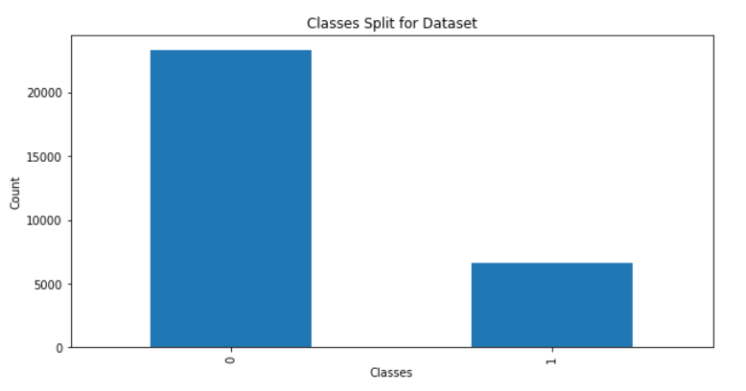
Data Cleaning
Tools & Technologies
Python
Jupyter
Numpy
Pandas
Scikit-Learn
Matplotlib
No null values were found in dataset.
Anomalies were present in EDUCATION column with values that were out of scope. All rows with such data were dropped.
As we can see, dataset is highly unbalanced.
SMOTE oversampling method was used to balance the dataset classes.
SMOTE is an oversampling technique where the synthetic samples are generated for the minority class

Slide 8
Predictive Modelling
Scaling
Standard scaler method was used to scale the data.
Train-Test Split
Data was divided into 80% training data and 20% for testing and evaluation of trained model.
Model Training
Random Forest classifier trained using scikit-learn library of Python.
Model Evaluation
Model will be evaluated using classification report and ROC curve.

Slide 9
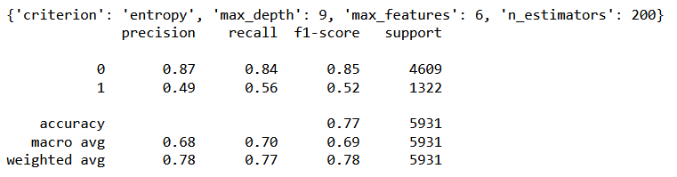
Model Evaluation
Random forest classifier will be evaluated using the classification report.
Model hyperparameters were optimized using the GridsearchCV function of Scikit-Learn.
Precision – 78%
Recall – 77%
F1-score – 78%
Accuracy – 77%

Slide 10
Model Evaluation
Precision value is 78% which means, out of every 100 default labeled people, 78 are going to default the payment actually next month.
In our case, recall is 77% which shows our model can predict positive cases correctly 77% of the time.
F1-score is 78% which means model’s predictions exactly matched with classification 78% of the time.
Accuracy value of 77% means that 23 of every 100 labels is incorrect, and 77 are correct. Which shows our model is performing moderately good and can make good predictions.

Slide 11
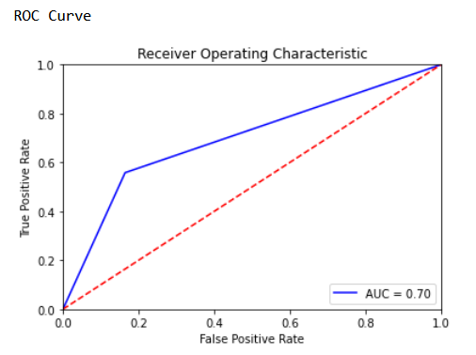
Model Evaluation
Receiver Operator characteristics (ROC) curve illustrates the performance of a classification model using two parameters: True positive rate and false positive rate.
AUC is area under the curve which is area between the blue line and axis. The bigger the area covered, the better the machine learning algorithm performs for classification.
For our Random Forest classification model AUC = 0.70 which means there is a high chance that the classification model will be able to classify the positive class values from the negative class values.

Slide 12
Implementation
The solution of this project and algorithm can be deployed into the system of any financial organization.
Financial advisers or line of credit authorization officers at bank may access this system and use it to know the probability of client’s payment default for upcoming month.
It can help organization to manage risks.
The solution can help institutions to reduce its NPA and payment defaults.
Moreover, they can save the resources and time which are being utilized to recover the payments from credit card clients.

Slide 13
Recommendations
Dataset used to train the algorithm was gathered in year 2005 and published in year 2016.
Systems and services has been changed in recent years in credit card and banking services.
To keep prediction model efficient and scalable, we need more data to train a robust machine learning mode to make more accurate predictions.
While collecting the new data, team needs to make sure that there is no outliers or anomalies present in the dataset.
It is recommended to solution’s front users that even after the model is deployed into financial organization’s system, enterprises need to keep reinforcing the algorithm with new datasets to improve the accuracy of predictions.

Slide 14


